Slide 1
Presentation of design solution Project Mapper
Team name
06/10/2020

Slide 2
Introduction
General facts about your project,

Slide 3
Team
Present your team and tell your client why this is the best team for this project.

Slide 4
Design specifications/Requirements
Contract : Autonomously create a map of a given area with a robot
Bronze :
Create an autonomous robot able to move in (x,y) axis on a flat surface
This robot has a way to measure the distance in front of him and report it to a remote system
The boundaries of the area are known and stable
Gold :
….
Silver :
….

Slide 5
Bronze solution : General architecture
Specification/functions :
The System shall move in straight line
The System shall detect an object
located at minimum 5cm in front.
W1
M1
C
W3
M2
W2
Design :
SSYS 1 : Locomotion
3 wheels and 2 motors
SSYS 2 : Sensor
1 infrared sensor
SSYS 3 : Calculator
1 Lego Mindstorm Brick
S
Explain the main components/subsystems
of your system, showing motors, sensors, etc.
Explain to your client WHY you chose this architecture

Slide 6
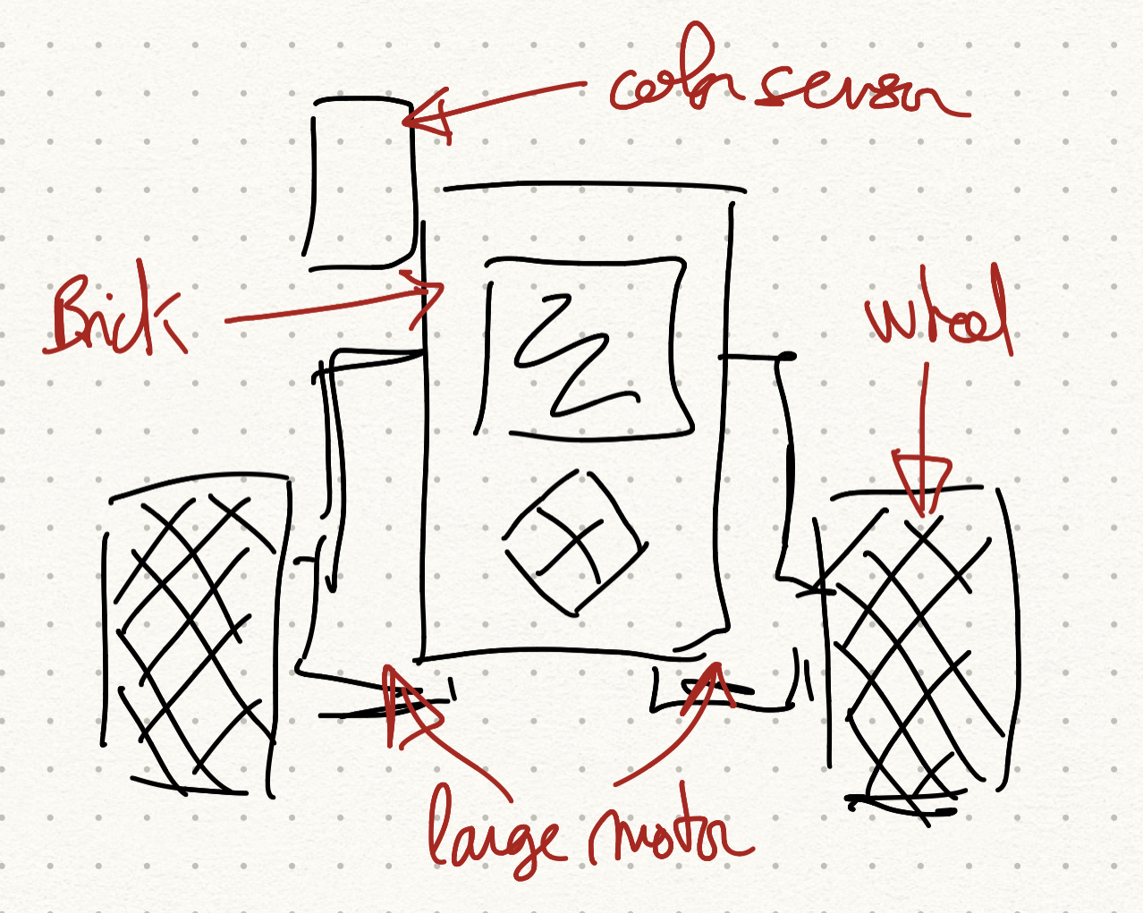
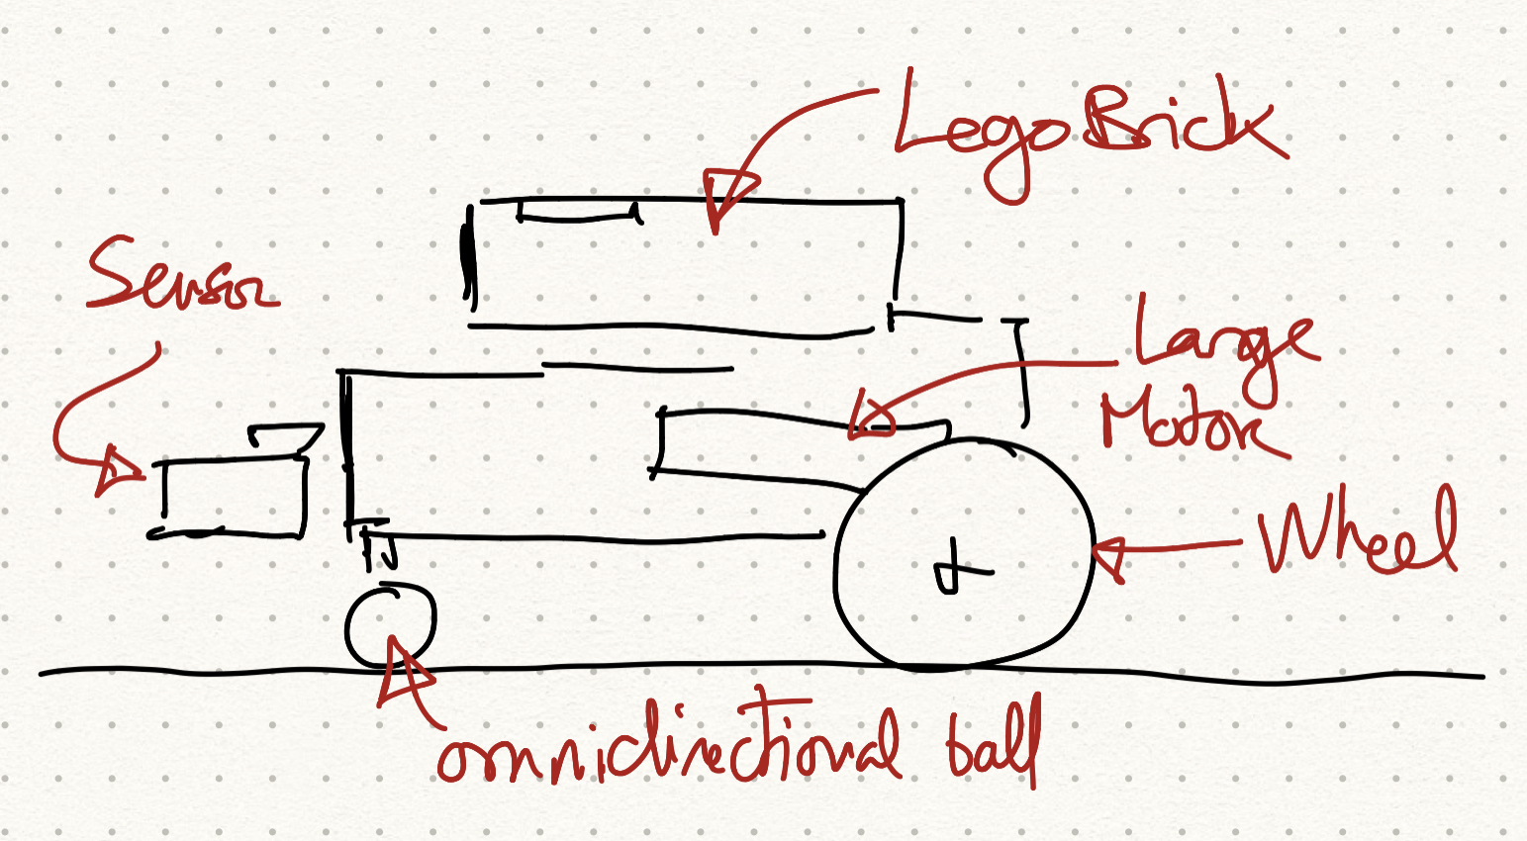
Bronze : Hardware design
Add schematics of your future robot
Side view Top view >

Slide 7
Bronze : Software solution
Create a simple and self explaining algorithm diagram explaining how your code will work.

Slide 8
Bronze : Validation
Test 1 : Test the straight line movement
Condition of tests :
Straight black line diagonally on a white paper square (1m x 1m)
Flat Surface, on the class ISEP hall
Initialization :
The robot is off at the corner of the square.
Action :
Start the robot and execute the test 10 times
Verification :
the robot could be at the opposite corner, with 3cm of error maximum.
30cm minimum

Slide 9
Bronze : Validation
Test 2 : Test …
Condition of tests :
Describe the test environment
Initialization :
What are the starting conditions
Action :
Describe robot actions.
Verification :
How do we measure success or failure.
30cm minimum

Slide 10
Silver solution

Slide 11
Silver : …
Explain what will change on the hardware / software / tests
Add all necessary tests.

Slide 12
Conclusion
Wrap up your presentation with a nice conclusion

